Slide 1



Understanding Open-Source Ecosystem:
AKASH PATIL , Assistant Professor
Computer Science & Engineering

Slide 2

CHAPTER-3
Understanding Open-Source Ecosystem:

Slide 3
The open-source ecosystem
The open-source ecosystem refers to the collective community, projects, tools, and resources that are built around the principles of open-source software development.
Open source is a collaborative approach to software development where the source code of a software project is made freely available to the public. This allows anyone to view, use, modify, and distribute the code.

Slide 4
The open-source ecosystem
Here are key components and concepts within the open-source ecosystem:
Open Source Software (OSS): This is software whose source code is published and made available to the public, allowing anyone to inspect, modify, and distribute it. Some well-known examples include the Linux operating system, the Apache web server, and the Mozilla Firefox web browser.
Licensing: Open-source software is typically released under licenses that grant users the right to use, modify, and distribute the software. Common open-source licenses include the GNU General Public License (GPL), MIT License, Apache License, and BSD License. Each license has its own terms and conditions, influencing how the software can be used and shared.

Slide 5
The open-source ecosystem
Version Control Systems: Version control is crucial in open-source development for tracking changes to the source code over time. Git is one of the most popular version control systems, and platforms like GitHub and GitLab provide hosting and collaboration tools for managing Git repositories.
Collaboration Platforms: These platforms facilitate collaboration among developers. GitHub, GitLab, and Bitbucket are examples where developers can host their projects, track issues, propose changes (pull requests), and collaborate with others.
Issue Tracking and Project Management: Tools like Jira, Trello, and GitHub Issues help manage tasks, track bugs, and coordinate development efforts within open-source projects.

Slide 6
The open-source ecosystem
Communication Channels: Open-source communities often rely on communication tools like mailing lists, forums, and chat platforms to discuss development, address issues, and coordinate efforts. Examples include mailing lists, forums, and platforms like Slack and Discord.
Package Managers: Many programming languages have package managers that simplify the process of installing, managing, and updating libraries and dependencies. Examples include npm (Node.js), pip (Python), and Maven (Java).
Documentation: Comprehensive and well-maintained documentation is crucial for open-source projects. It helps users understand how to use the software, contributes to onboarding new developers, and facilitates collaboration.

Slide 7
The open-source ecosystem
Continuous Integration/Continuous Deployment (CI/CD): CI/CD tools automate the testing and deployment processes, ensuring that changes to the codebase are tested and integrated smoothly. Jenkins, Travis CI, and CircleCI are popular CI/CD tools.
Community: Open-source projects thrive on the contributions and support of a diverse community. This includes developers, users, testers, documenters, and other contributors. A healthy community fosters collaboration, innovation, and sustainability.

Slide 8
Open-Source Operating Systems:
Several open-source operating systems exist, covering a wide range of devices and use cases. Here are some prominent examples:
Linux:
Description: Linux is a Unix-like operating system kernel initially developed by Linus Torvalds in 1991. The kernel is the core component, and various distributions (distros) package it with additional software to create complete operating systems.
Examples of Linux Distros:
Ubuntu
Fedora
Debian
CentOS
Arch Linux
openSUSE

Slide 9
Open-Source Operating Systems:
BSD (Berkeley Software Distribution):
Description: BSD refers to a family of Unix-like operating systems descended from the Berkeley Software Distribution version of the Unix operating system. It includes various flavors like FreeBSD, OpenBSD, and NetBSD.
Examples:
FreeBSD
OpenBSD
NetBSD
DragonFly BSD

Slide 10
Open-Source Operating Systems:
ReactOS:
Description: ReactOS is an open-source operating system that aims to be compatible with Windows applications and drivers. It is a work in progress and seeks to provide a free and open-source alternative to Microsoft Windows.
Haiku:
Description: Haiku is an open-source operating system inspired by the Be Operating System (BeOS). It is designed for personal computing and provides a modern, consistent user interface.
FreeDOS:
Description: FreeDOS is a free and open-source operating system compatible with MS-DOS. It is primarily used for running legacy software and games that require a DOS environment.

Slide 11
Open-Source Operating Systems:
Tails:
Description: Tails (The Amnesic Incognito Live System) is a privacy-focused live operating system that aims to leave no trace unless explicitly asked. It is designed to be booted as a live USB or DVD.
OpenWrt:
Description: OpenWrt is an open-source firmware for embedded devices such as routers. It provides a customizable Linux distribution for networking devices.
Chromium OS:
Description: Chromium OS is the open-source project behind Google's Chrome OS. While Chrome OS is Google's commercial version designed for Chromebooks, Chromium OS is available as an open-source project that developers can use and modify.

Slide 12
Open-Source Operating Systems:
GNU Hurd:
Description: GNU Hurd is a collection of servers that run on top of a microkernel, forming the basis of the GNU operating system. While it is less commonly used than the Linux kernel in the GNU system, it is an ongoing project.
AOSC OS:
Description: AOSC OS is an open-source Linux distribution that aims to provide a simple, reliable, and user-friendly experience. It supports multiple architectures and includes a variety of desktop environments.
These operating systems vary in their intended use cases, ranging from general-purpose computing to specialized applications like networking or privacy-focused systems. The open-source nature of these projects promotes collaboration, transparency, and customization by allowing users and developers to inspect, modify, and distribute the source code.

Slide 13
Open-Source Hardware
Open-source hardware refers to physical devices, components, and systems whose designs are made available to the public. This allows anyone to study, modify, distribute, and even manufacture the hardware based on the provided specifications.
Similar to open-source software, the philosophy behind open-source hardware is rooted in transparency, collaboration, and the idea that sharing designs can lead to innovation and improvement.
Here are some key aspects of open-source hardware:
Hardware Designs:
Open-source hardware projects typically provide detailed documentation, schematics, and design files that describe how the hardware is built. This information is often shared through platforms like GitHub.

Slide 14
Open-Source Hardware
Licensing:
Just like open-source software, open-source hardware is released under specific licenses that dictate how the designs can be used, modified, and shared. Common licenses include the CERN Open Hardware License (OHL), TAPR Open Hardware License, and Creative Commons licenses.
Community Collaboration:
Open-source hardware projects benefit from community collaboration. Developers, engineers, and enthusiasts can contribute to the improvement of designs, report issues, and propose modifications. This collaborative approach can lead to more robust and innovative hardware.

Slide 15
Open-Source Hardware
Examples of Open-Source Hardware:
Arduino:
Arduino is an open-source hardware and software platform designed for hobbyists, artists, and developers to create interactive electronic projects. Arduino boards are widely used for prototyping and education.
Raspberry Pi:
While the Raspberry Pi's hardware is not entirely open source, its schematics are available for reference, and it has a large community contributing to its ecosystem. The Raspberry Pi Foundation promotes accessibility to computing and digital skills.
Open Source Ecology (OSE):
OSE is a project that aims to create open-source blueprints for building essential machines and tools needed for a sustainable and self-sufficient community. Examples include 3D printers, tractors, and other industrial machines.

Slide 16
Open-Source Hardware
Fab Labs and Makerspaces:
Fab Labs (fabrication laboratories) and makerspaces often embrace open-source hardware principles. These are community spaces equipped with tools and resources for individuals to create and prototype physical projects collaboratively.
Open Source Computer Hardware:
Some projects focus on open-source computer hardware, including motherboards, CPUs, and graphics cards. While these projects might not yet have the same widespread adoption as traditional hardware, they contribute to the idea of a more open and transparent computing ecosystem.
Open-source hardware fosters innovation, education, and accessibility by allowing a diverse range of people to participate in the creation and improvement of technology. It can lead to more sustainable and customizable solutions, especially in fields like education, research, and community-driven projects.

Slide 17
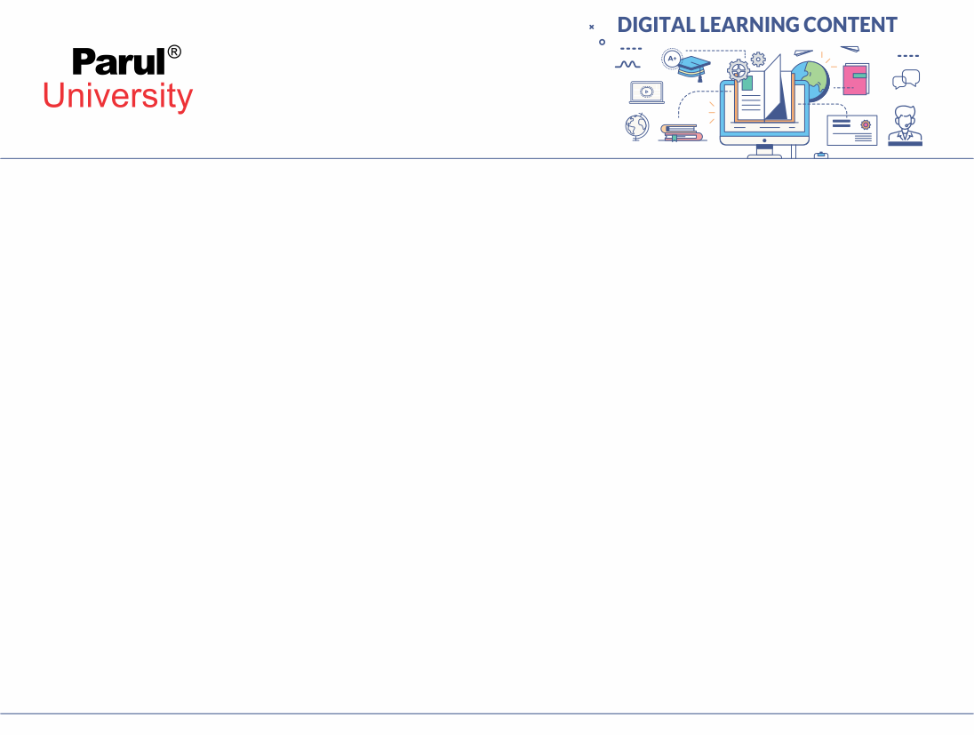

Virtualization Technologies
Virtualization technologies are software-based technologies that allow multiple virtual instances of operating systems or applications to run on a single physical computer or server. Virtualization provides a way to utilize hardware resources more efficiently, improve scalability, and enhance the flexibility and manageability of IT environments.
Here are some of the key virtualization technologies:
Xen: An open-source hypervisor developed by the Xen Project. It can run on both x86 and ARM architectures and is commonly used in cloud computing environments.
Oracle VirtualBox: An open-source virtualization software that supports running multiple guest operating systems on various host systems.
Parallels Desktop: A virtualization software for macOS that enables users to run multiple guest operating systems on a Mac computer.
Microsoft App-V (Application Virtualization): Allows applications to be delivered to users as virtual applications, decoupling them from the underlying operating system.

Slide 18
5.Hypervisor (Virtual Machine Monitor - VMM): A hypervisor is a software layer that allows multiple virtual machines (VMs) to run on a single physical machine. There are two main types of hypervisors: Type 1 (bare-metal) and Type 2 (hosted). Type 1 hypervisors run directly on the hardware, while Type 2 hypervisors run on top of a host operating system.
6.VMware vSphere/ESXi: Developed by VMware, vSphere is a suite of virtualization products, with ESXi being the bare-metal hypervisor that powers it. vSphere provides various features for managing and optimizing virtualized environments.
7.Microsoft Hyper-V: Microsoft's virtualization platform, which comes as a role in Windows Server. Hyper-V allows users to create and manage virtual machines on Windows-based systems.

Slide 19
Containerization Technologies
By default, containerization technology derives from virtualization's advancements. Another common name for it is OS-level virtualization.
Containerization is all about packaging the requirements of an application under development in the form of a base image. This image can run in an isolated space (containers) on different systems. It is crucial to remember that these containers share the same OS.
Types of containers
Docker: a containerized platform that is open-sourced and mixes an app's source code with the existing OS and all of its relevant libraries and dependencies. It enables the running of the relevant code in any computing environment.
LXC: An OS-based container that, if it includes a single Linux kernel acting as the host OS, enables an app to operate on numerous Linux computers virtually.

Slide 20
Development Tool Kit
A development toolkit, also known as a software development toolkit or SDK (Software Development Kit), is a set of software tools, libraries, and resources that developers use to create applications or software for a specific platform, operating system, or programming language. These toolkits streamline the development process by providing pre-built functions and APIs (Application Programming Interfaces) that allow developers to interact with the platform's features and services.
The specific components of a development toolkit can vary depending on the target platform or programming language, but some common elements may include:
Libraries: Pre-written code modules that provide functionality for common tasks, such as handling graphics, networking, data processing, etc.
APIs: Interfaces that allow applications to interact with the underlying platform, operating system, or other services. This could include APIs for accessing hardware features, system functions, cloud services, etc.

Slide 21
3. Sample Code: Code examples that demonstrate how to use different components of the toolkit in practical applications.
4. Compiler or Interpreter: Tools to translate source code into machine code or bytecode that can be executed on the target platform.
5. Debugging Tools: Tools for identifying and fixing errors and issues in the code during the development process.
6. Profiling Tools: Tools that analyse the performance of the application to identify bottlenecks and areas for optimization.

Slide 22
Examples of popular development toolkits include:
Android SDK: For developing applications for the Android operating system.
iOS SDK: For developing applications for Apple's iOS platform.
.NET Framework: A development framework for building Windows applications and web services.
Java Development Kit (JDK): For developing Java applications.
Node.js: A JavaScript runtime that includes a variety of libraries for building server-side applications.
Unity: A popular game development platform that provides various tools and libraries for creating games.

Slide 23
Debuggers
Debuggers are essential tools used by developers to identify and fix bugs or issues in software code. They allow programmers to closely examine the program's execution, inspect variables and data, and track the flow of the code to understand how the program behaves. Debugging is a crucial part of the software development process, as it helps ensure the reliability and correctness of the final product.
Key features of debuggers include:
Breakpoints: Developers can set breakpoints in the code, which pause the program's execution at a specific line or function. This allows them to inspect the program's state at that point and step through the code one line at a time.

Slide 24
Debuggers
Popular debuggers vary depending on the programming language and platform being used. Some widely used debuggers include:
GDB (GNU Debugger): A powerful open-source debugger commonly used for C, C++, and other languages.
LLDB: A debugger commonly used for macOS and iOS development.
Visual Studio Debugger: Integrated into Microsoft Visual Studio IDE for debugging .NET applications and other languages.
Xcode Debugger: Integrated into Apple's Xcode IDE for debugging macOS and iOS applications.

Slide 25
Programming Language
A programming language is a formal language designed to instruct a computer to perform specific tasks. It serves as a means of communication between humans and computers, allowing programmers to write instructions in a format that the computer can understand and execute. Programming languages are used to develop software applications, scripts, algorithms, and other computational tasks.
There are numerous programming languages available, each with its own syntax, semantics, and features. Some popular programming languages as of my last update in September 2021 include:
Python , C , C++ , Java , ……etc.

Slide 26
LAMP
LAMP is an acronym that refers to a popular and commonly used software stack for web development. It is an open-source solution that combines four key components to create dynamic and robust web applications. Each letter in the LAMP acronym represents one of these components:
Linux: The operating system (OS) of the server hosting the web application. Linux is chosen for its stability, security, and cost-effectiveness. It provides the foundation for the entire LAMP stack.
Apache: The web server software that handles incoming HTTP requests from web browsers and serves web pages and resources to users. Apache is one of the most widely used web servers and is known for its reliability and flexibility.
MySQL: A relational database management system (RDBMS) used to store and manage the application's data. MySQL is popular for its speed, scalability, and ease of use, making it a favoured choice for web applications.
PHP: A server-side scripting language used for creating dynamic web content. PHP is embedded within HTML to generate web pages on the server before sending them to the client's browser.

Slide 27
Open Source Database Technologies
Open-source database technologies are database management systems (DBMS) that are released under open-source licenses, allowing users to access, modify, and distribute the source code freely. These databases offer an alternative to proprietary solutions and have gained significant popularity due to their cost-effectiveness, flexibility, and active community support.
Some of the prominent open-source database technologies as of my last update in September 2021 include:
MySQL: One of the most popular open-source relational database management systems. MySQL is widely used for web applications, content management systems, and various other applications requiring a robust and scalable database.
PostgreSQL: A powerful and feature-rich open-source object-relational database system. PostgreSQL is known for its extensibility, support for advanced data types, and compliance with SQL standards.

Slide 28
Open Source Database Technologies
3. MariaDB: A fork of MySQL, created by the original developers of MySQL. MariaDB retains MySQL's core functionality while adding new features and performance improvements.
4. MongoDB: An open-source NoSQL database that uses a document-oriented data model. MongoDB is well-suited for handling unstructured or semi-structured data and is commonly used in modern web applications and big data solutions.
5. SQLite: A self-contained, serverless, and zero-configuration open-source database engine. SQLite is widely used in embedded systems, mobile apps, and as a local storage solution for desktop applications.

Slide 29
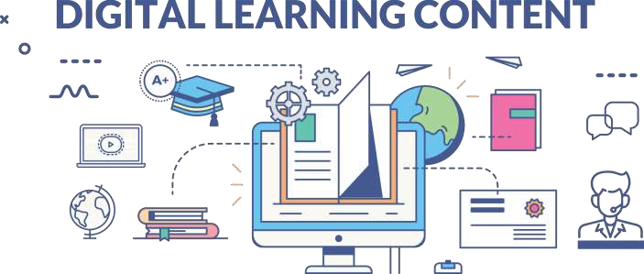

www.paruluniversity.ac.in

